Slide 1

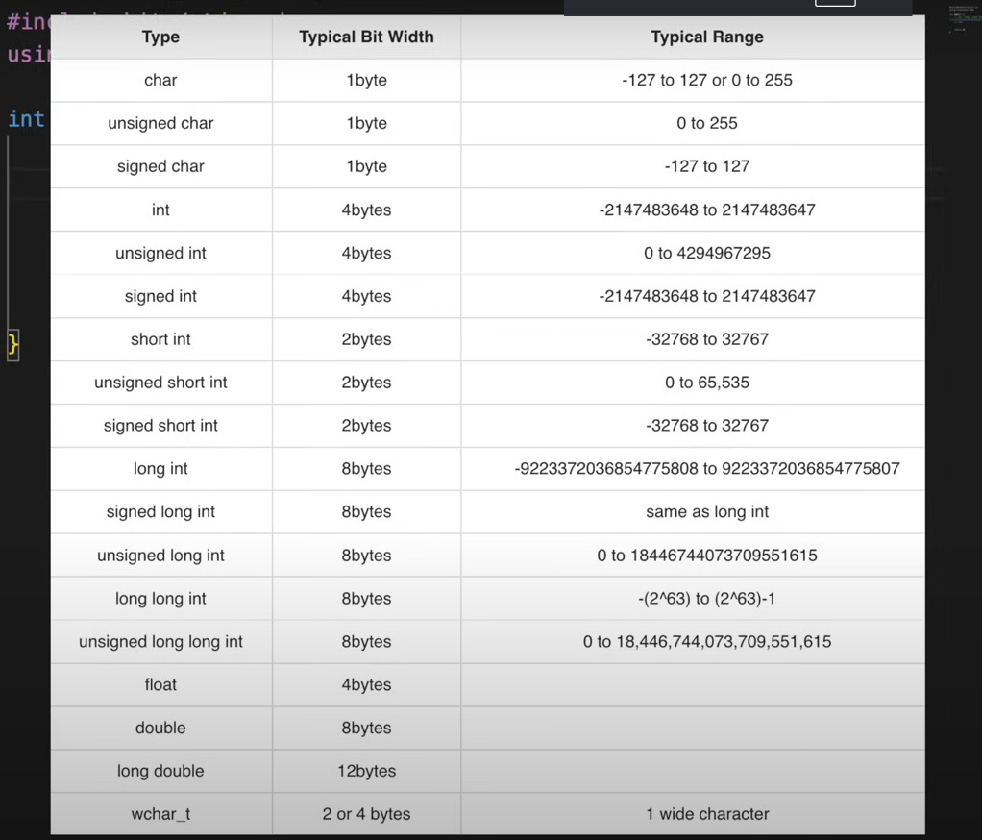
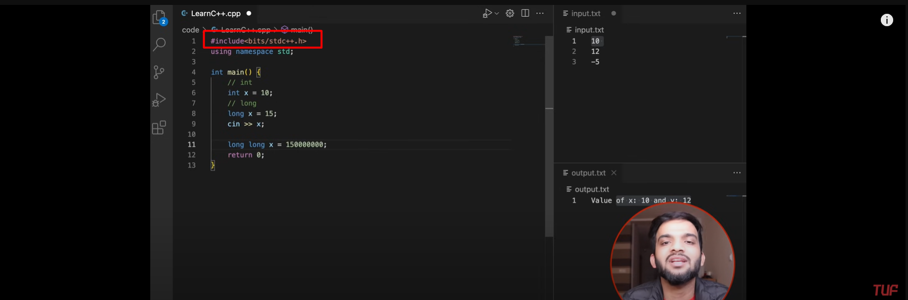

Slide 2
Library that includes everything (time taken is negligible in comparison to the running of the code
Rounding off the ranges of datatypes for remembering them
Else if is faster than multiple if statements
->They do not check every else if block
->The condition for else if block is trimmed
4. Nested if doesn’t save time but are sure very intuitive
5. break statements breaks out of all the conditional statements (including switch cases as they are conditional too)

Slide 3
Rounded of range of different datatypes
Int->-10^9 to 10^9
Long -> -10^12 to 10^12
Long long -> -10^18 to 10^18

Slide 4
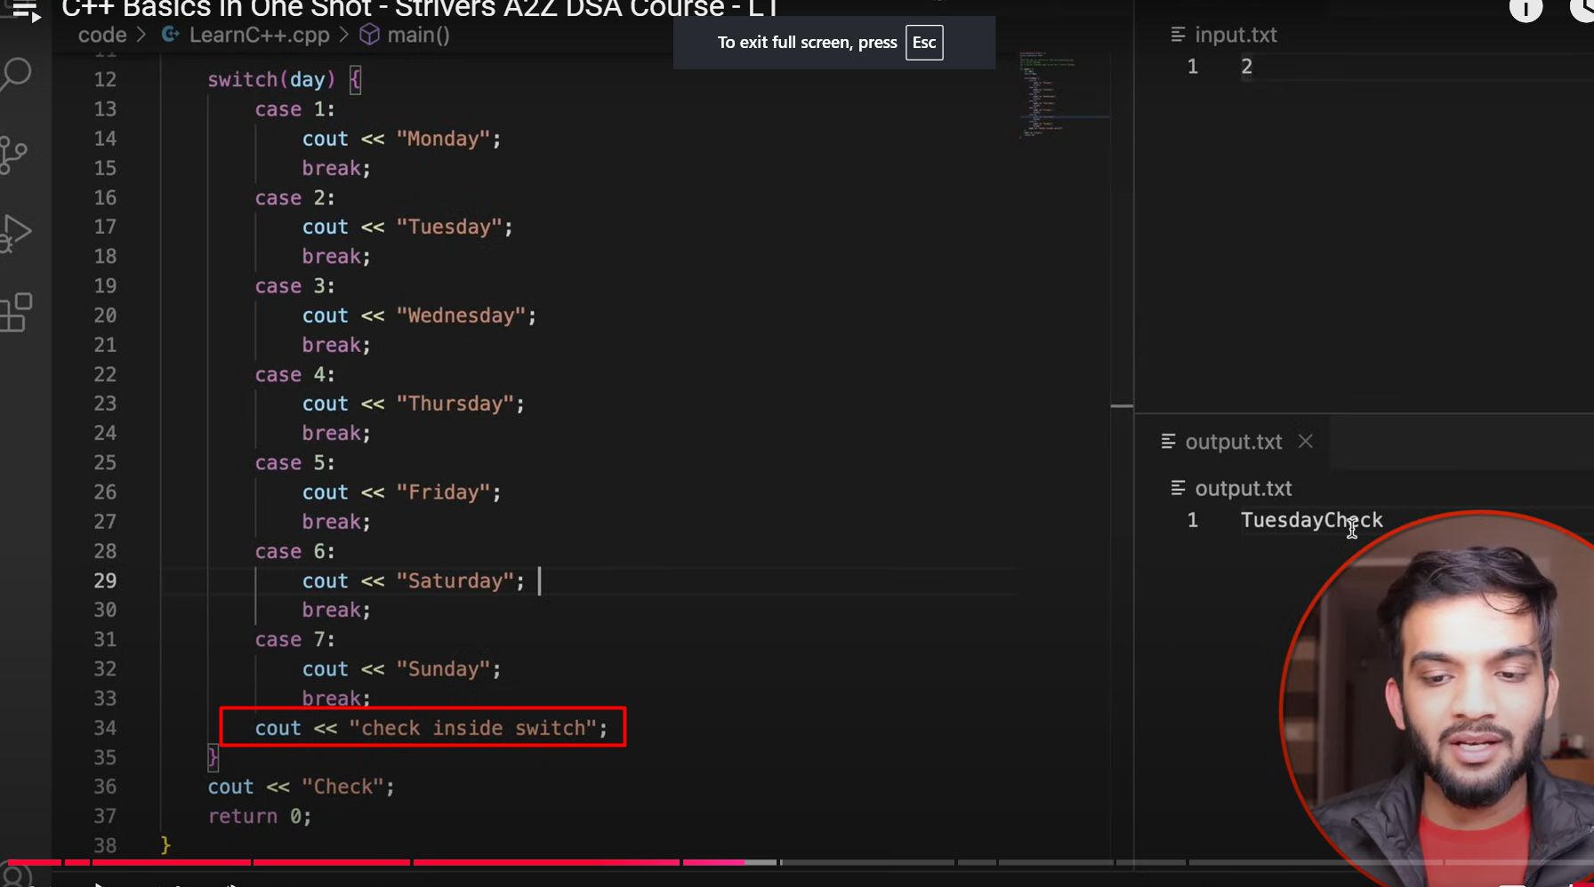
The highlighted check statement will not be executed since its still considered a part of switch which passes only one condition and thus the statement that is present outside will be executed only once

Slide 5
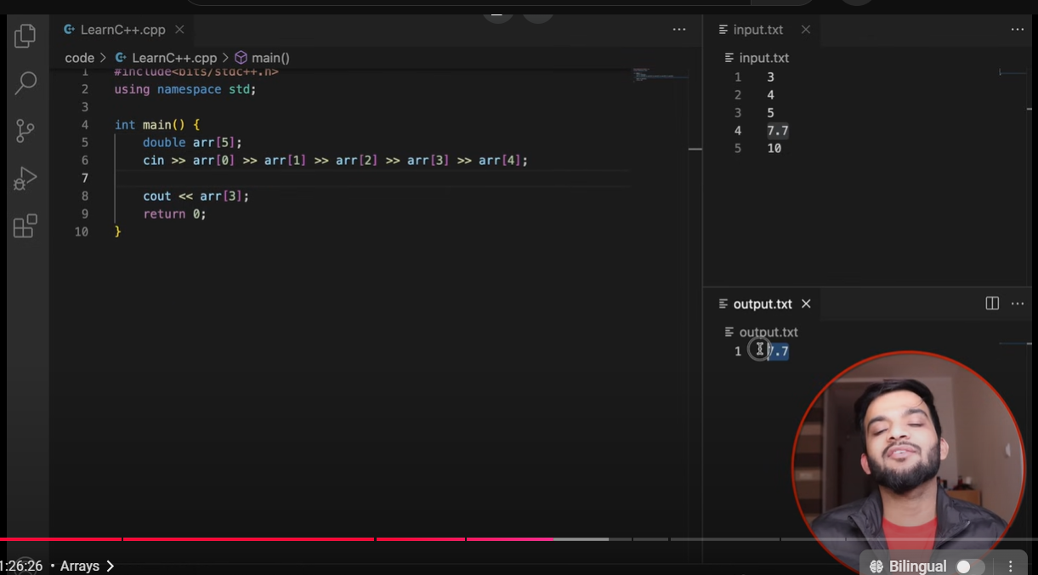
the first element in an array can be stored anywhere in the CPU(so we can’t predict where it can be sure but we only the exact address after its stored) however for the subsequent elements we can be sure that they will be consecutive to each other.

Slide 6
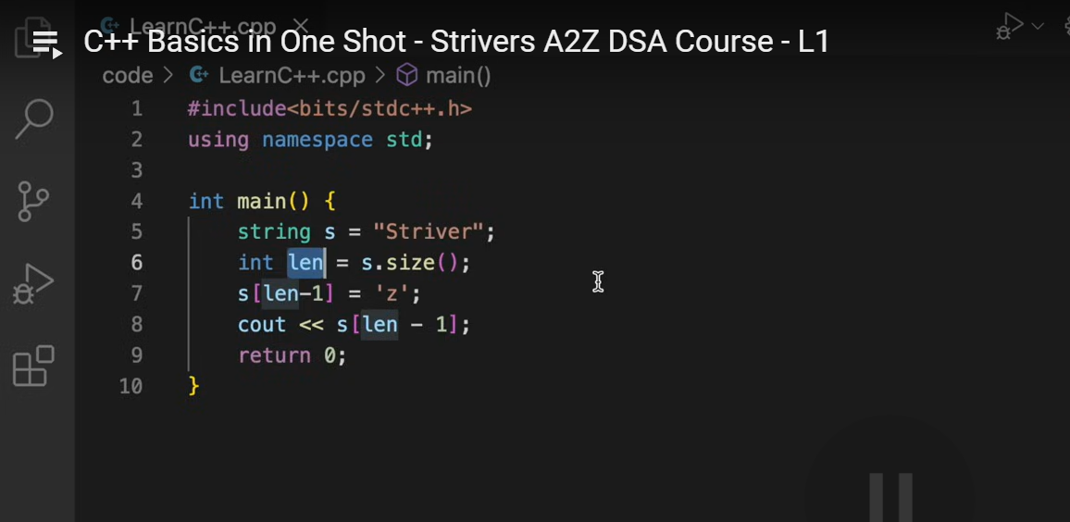
Summary: Mutable vs Immutable Strings
C++ (std::string) → Mutable, modifications happen in place without creating a new object.
Java (String) → Immutable, any modification creates a new object, and reassignment is needed.
Python (str) → Immutable, modifying a string results in a new object, requiring reassignment.
All other primitive datatypes are immutable however arrays are mutable and classes are mutable by default but we can make them immutable explicitly

Slide 7
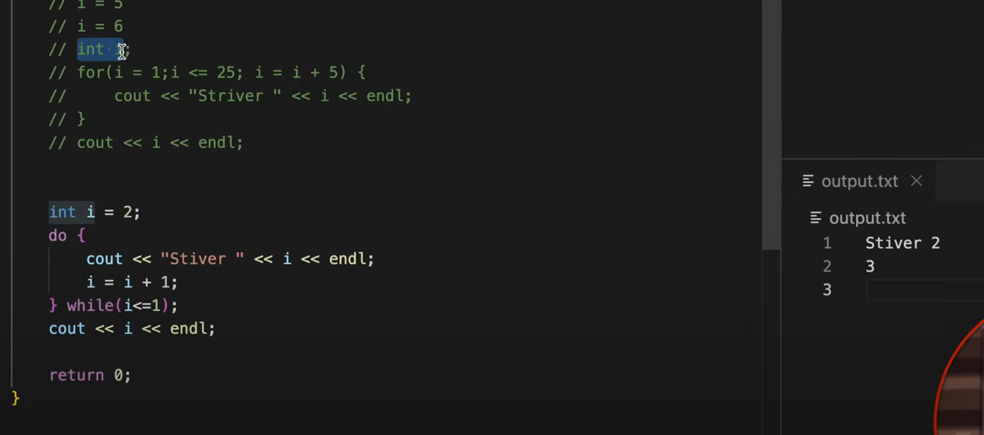
Do –while loop executes at least once even if the condition is false to enter in the while loop

Slide 8
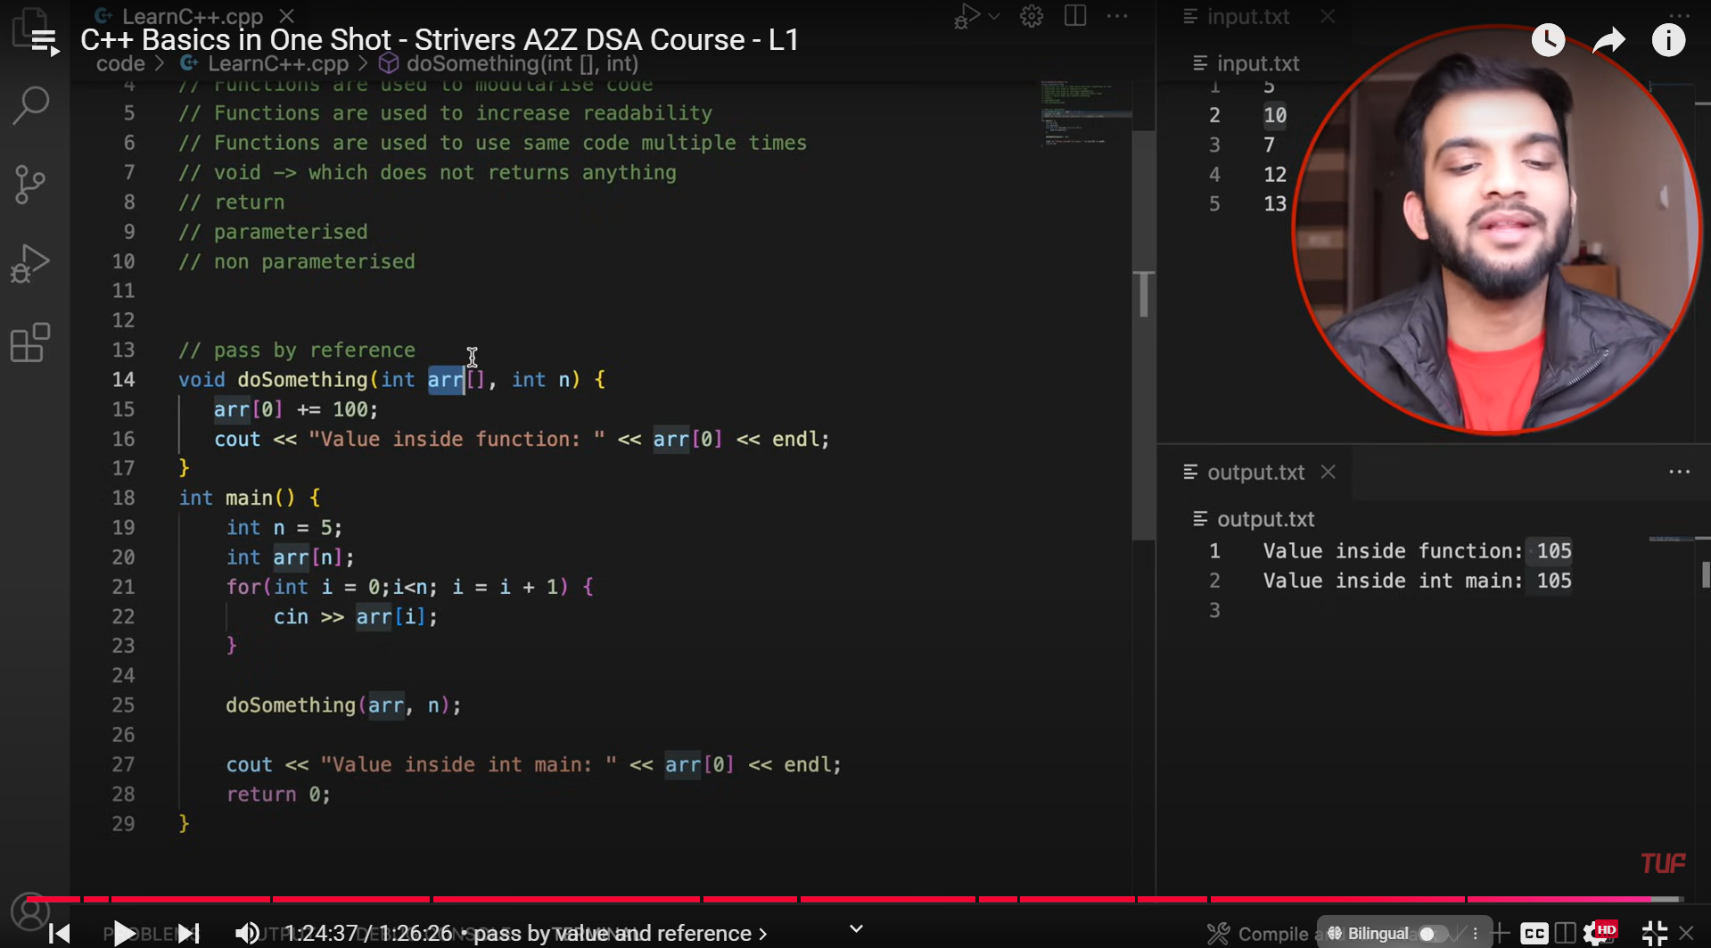
Arrays always get passed by reference (by default) but other STLs…you must use ‘&’ to make sure that they are passed by reference but not with array

